Slide 1
RPL Meeting 7/6
Stiles Jarrett
Sam Kelly

Slide 2
Sam Kelly
I’m freshman at Illinois State University. I’m majoring in Physics Education. I plan to be a high school physics teacher in Chicago.

Slide 3
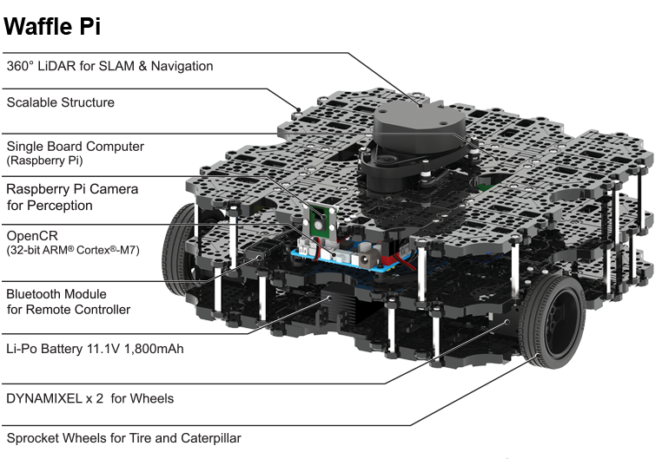
Current project
Utilize IR sensors on Garby JR. (Turtlebot 3 waffle pi)
to procedurally scan the lab in order to collect and
deposit trash into a trash can
Current progress
Current Problems
We recently had to start from square one on our
robot because we moved from the icreate to the turtlebot.
We were unable to install many of the necessary pre-requisites
on our laptop because our assigned laptops have admin restrictions.

Slide 4
RPL Meeting 7/13
Stiles Jarrett
Sam Kelly

Slide 5
Current project
Utilize IR sensors on Garby JR. (Turtlebot 3 waffle pi)
to procedurally scan the lab in order to collect and
deposit trash into a trash can
Current progress
Current Problems
We are currently in the process of setting up wifi on the
Raspberry pi attached to the robot in order to install
Gazebo and connect to a remote pc
In order to connect the turtlebot to wifi you need to install
a package that requires wifi to install. We need to figure
out a way to install the package on a computer before
we add it to the turtlebot

Slide 6
RPL MEETING 7/20/23
Stiles and Sam

Slide 7
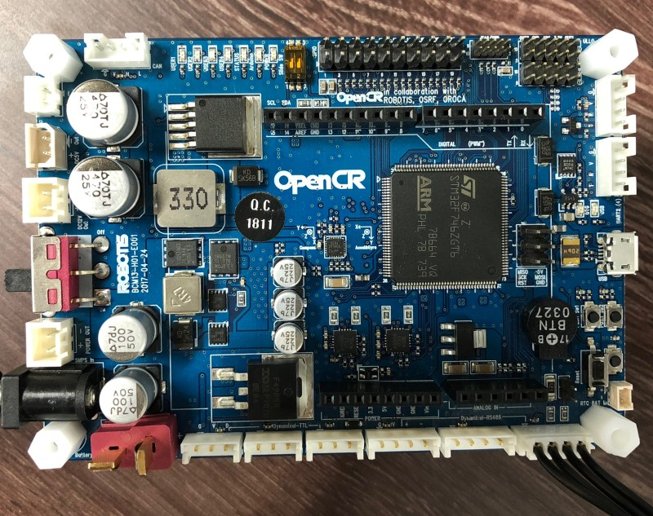
Current progress:
We have succeeded in fixing the wifi drivers on the raspberry pi, and we have also fixed the Dynamixels attached to the Turtlebot that were previously not functioning properly
Current problems:
We are still trying to learn what the functions on the OpenCR
actually do
Next Steps:
We plan to make the turtlebot move in a single defined area
and then move on to mapping out a larger portion of the room and navigating it

Slide 8
RPL MEETING
7/27/23

Slide 9
Current progress:
This week we are back at square one (I know we’re making great progress), we have reinstalled the Netplan package and started work on installing the dependencies for gazebo.
Current problems:
Next steps:
Everything.
Our next steps are to figure out why we can’t get the Netplan package to actually work and then fix it so we can finish installing the dependencies for gazebo.

